Slide 1
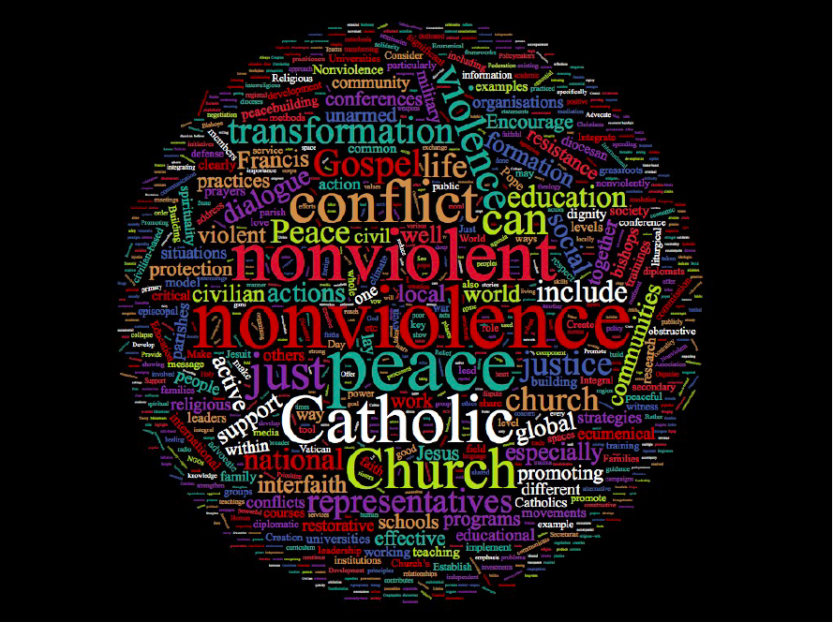
Integrating Nonviolence Throughout the Church

Slide 2
Imagining 2119…

Slide 3
2119
Celebrating 100 years of integrating nonviolence at every level of the Church

Slide 4
2119
Celebrating 100 years of integrating nonviolence at every level of the Church
The power of this renewal

Slide 5
2119
Celebrating 100 years of integrating nonviolence at every level of the Church
The power of this renewal
Theology, formation and practice of active nonviolence

Slide 6
2119
Celebrating 100 years of integrating nonviolence at every level of the Church
The power of this renewal
Theology, formation and practice of active nonviolence
Healing violence within

Slide 7
2119
Celebrating 100 years of integrating nonviolence at every level of the Church
The power of this renewal
Theology, formation and practice of active nonviolence
Healing violence within
Call to the world

Slide 8
But it is still 2019

Slide 9
2019
Boldly rededicating the Church to nonviolence

Slide 10
2019
Boldly rededicating the Church to nonviolence
The hope for an encyclical

Slide 11
2019
Boldly rededicating the Church to nonviolence
The hope for an encyclical
Increase in the research, study and application of the biblical, theological, ethical, pastoral and strategic dimensions of nonviolence

Slide 12
2019
Nonviolence in dioceses, parishes, seminaries, universities, schools and religious orders and congregations

Slide 13
2019
Nonviolence in dioceses, parishes, seminaries, universities, schools and religious orders and congregations
Preaching, sacraments, ministries, spirituality, and formation

Slide 14
2019
Nonviolence in dioceses, parishes, seminaries, universities, schools and religious orders and congregations
Preaching, sacraments, ministries, spirituality, and formation
Training in “love your enemies”

Slide 15
2019
Nonviolence in dioceses, parishes, seminaries, universities, schools and religious orders and congregations
Preaching, sacraments, ministries, spirituality, and formation
Training in “love your enemies”
Church offices promoting nonviolence

Slide 16
2019
A new moral framework for Catholic teaching on violence and war

Slide 17
2019
A new moral framework for Catholic teaching on violence and war
The language of the institutional Church as a moral authority more consistent with the nonviolent creativity of the Gospel

Slide 18
2019
A new moral framework for Catholic teaching on violence and war
The language of the institutional Church as a moral authority more consistent with the nonviolent creativity of the Gospel
Jesus taught us to put down our sword, to offer no violent resistance to the one who does evil, and to not kill.

Slide 19
2019
Promoting and spreading the methods of nonviolence and just peace

Slide 20
2019
Promoting and spreading the methods of nonviolence and just peace
All Catholics trained to transform conflict and prevent violence

Slide 21
2019
Promoting and spreading the methods of nonviolence and just peace
All Catholics trained to transform conflict and prevent violence
Strong participation in unarmed civilian protection

Slide 22
2019
Promoting and spreading the methods of nonviolence and just peace
All Catholics trained to transform conflict and prevent violence
Strong participation in unarmed civilian protection
Strategic nonviolent campaigns

Slide 23
2019
Promoting and spreading the methods of nonviolence and just peace
All Catholics trained to transform conflict and prevent violence
Strong participation in unarmed civilian protection
Strategic nonviolent campaigns
Investment in nonviolent options

Slide 24
2019
Initiating a global conversation on nonviolence

Slide 25
2019
Initiating a global conversation on nonviolence
Dramatic increase in discussion of the power of active nonviolence within the Church, with people of other religious traditions, and with the larger world

Slide 26
2019
The Catholic Church can help spark the nonviolent shift crucially needed to respond to the crises of our time

Slide 27
2019
The Catholic Church can help spark the nonviolent shift crucially needed to respond to the crises of our time
Catholics make up 18 percent of the world population, with 1.3 billion people

Slide 28
2019
The Catholic Church can help spark the nonviolent shift crucially needed to respond to the crises of our time
Catholics make up 18 percent of the world population, with 1.3 billion people
Largest nonprofit organization

Slide 29
2019
The Catholic Church can help spark the nonviolent shift crucially needed to respond to the crises of our time
Catholics make up 18 percent of the world population, with 1.3 billion people
Largest nonprofit organization
Worldwide diplomatic presence

Slide 30
2019
The Church can be a global leader of nonviolence
To help the world challenge the catastrophe of systemic violence
To encourage the world to nurture nonviolent alternatives
There could be powerful impacts – maybe sooner than 100 years

Slide 31
Integrating Nonviolence Throughout the Church

